Slide 1
Performance Optimization in PHP OOP

Slide 2
Performance Considerations in PHP OOP
Object Creation Overhead
Creating many objects uses more memory and CPU.
Solution: Reuse objects when possible and avoid creating inside loops.
Avoid Deep Inheritance Trees
Too many class layers slow down method resolution.
Solution: Use composition instead of overusing inheritance.
Use Magic Methods Sparingly
Methods like __get(), __set() are flexible but slow.
Solution: Access properties and methods directly when possible.
Use Native Functions Over Custom Code
Native functions (in_array(), array_map()) are faster than user-defined equivalents.
Solution: Always check for a built-in PHP function first.
Enable and Optimize OPCache
Speeds up PHP by storing precompiled scripts in memory.
Solution: Enable OPCache in php.ini for faster performance.

Slide 3
Profiling and Benchmarking PHP Code
What is Benchmarking?
Measuring the execution time of parts of your code to identify performance bottlenecks.
What is Profiling?
Analyzing which functions or processes take the most time or memory during execution.

Slide 4
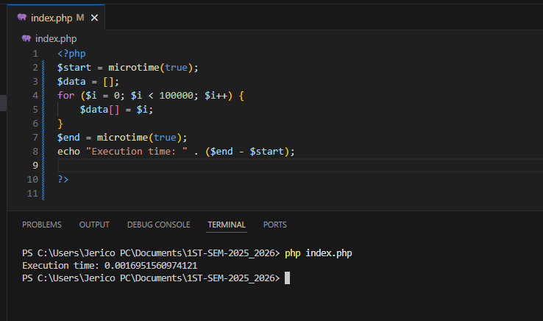
Example Benchmarking Code

Slide 5
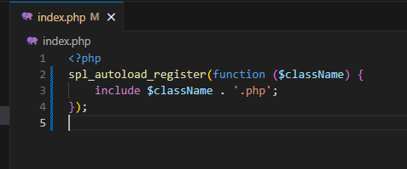
Code Optimization Techniques
1. Use Autoloading Instead of Manual Includes
-Avoid using require or include repeatedly.
Use spl_autoload_register() to load classes on demand.
Improves performance by loading only what's needed.

Slide 6
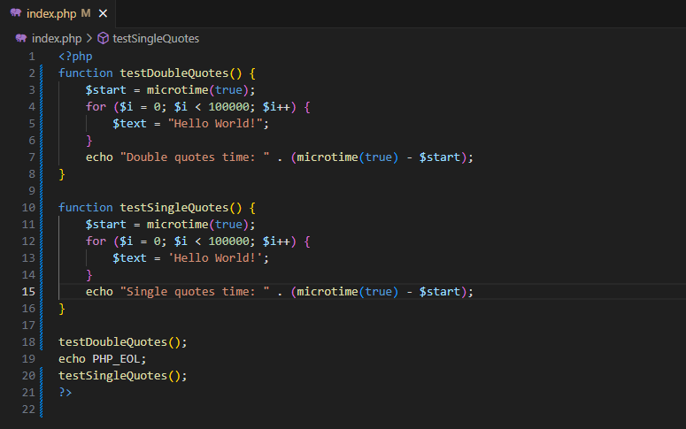
Code Optimization Techniques
2. Single and double quote usage matters
This may seem the last thing developers should care about, but there has been a lot of tests conducted to prove using single quotes, especially in larger loops and strings, is significantly faster than using double quotes.
Notes:
https://stackify.com/php-performance-optimization-guide/

Slide 7
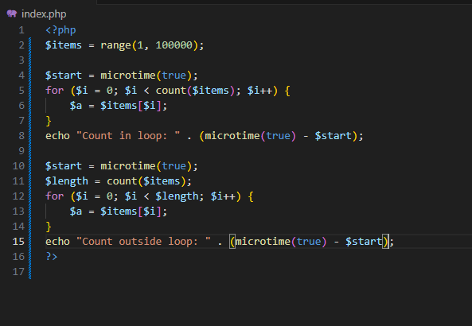
Code Optimization Techniques
3. Effect of count function in loops
Using the count() function inside loops can significantly affect performance in PHP — especially when counting arrays repeatedly in every iteration.
Notes:
https://stackify.com/php-performance-optimization-guide/

